Slide 1

Session : 2
Data Science & AI BOOTCAMP Session
“Our Limit is the Space”

Slide 2




Data Science & AI Board
Eng. Saher Muhamed
Head of Data Science & AI
Eng. Ziad Mostafa
Vice Head of Data Science & Ai
SWE @Shipd || Ex. Data Analyst @ Digitell || Ex. Data Science Intern @ TaQa-Arabia || IBM & Google Certified Data Analyst
Microsoft Certified Data Scientist || Ex. Data Scientist @ ZeNN || Ex. Data Analyst Intern @ ENAKL || Ex. Data Science Trainee @ SHAI For AI

Slide 3












Data Science & AI Core Team
Eng. Mohamed Ashraf
Data Scientist
||BI Trainee @ITI
Eng. Mohamed Shehab Core Team Data Science & AI
@GDG-On Campus ||
Data Analysis Trainee @Growth-Level
Eng. Mostafa Eliwa
Microsoft Certified
Machine Learning @DEPI
|| Second Place At DEPI
Grad-Projects Competition Overall Egypt
Eng. Ibrahim Said Mosa
AI systems member
Technical member at GHOSTECH(2023) event @IEEE-BUB ||
Core Team member
@GDG-On Campus
Eng. Azza Yehya
Kaggle Expert || Data Analyst Trainee @ PEA Learn Company || AI Diploma Graduate @ MEC Academy
Eng. Ibrahim Abdelfatah
Data Science & AI core team member @GDG-BUE || Electrical engineering student || Graduated Data Scientist from DEPI Microsoft SC EELU Data Science student
Eng. Mostafa Sobieh
data analyst|| BI Development internship from ITI || core team & instructor data science & AI @ GDG On Campus
Eng. Habiba Khaled
Microsoft certified data engineer@depiBI trainee@iticoding insrtucor@idevelopercore-team member@gdg on campus
Eng. Wafaa Ahmed
Core team member at GDG BenhaITI trainee
Eng. Mohamed Ashraf
Data Scientist
||BI Trainee @ITI
Eng. Nada Mohamed Data Analyst & Scientist Core team Data Science & AI @ GDG on Campus Trainee to CodeAlpha
Eng. Naira Zidan
Orange certified AI trainee || Old Core-team data analysis

Slide 4












Data Science & AI Core Team
Eng. Ganna Mahmoud
Data Scientist || Core Team Data Science & AI @GDG-On Campus|| BI Trainee @ITI
Eng. Abdelrahman Amr Data Analyst and Scientist || Core Team Data Science and AI @GDG-On Campus || Laptop Maintenance Engineer
Eng. Muhammed Al Reay
Data science & AI @GDG on-campus || IT&Sap Trainee @EIM Group
Eng. Shahd yehia
Core team member @ GDG_On Campus Datacamp certified data analyst
Eng. Reem Kasab
student @BFCAI || Data Science trainee @DEPI || AI member @IEEE ||Data science member @GDG on campus
Eng. Nour Adel
CORE TEAM | DATA SCIENCE AND AI @ GDG ON CAMPUS
Eng. malak Abd Elgwad Core team in Data science &AI@ gdg google developer _on campus.Data science trainee
Eng. Habiba Mohamed
Core team member of Data Science & Ai @GDG- On Campus || Business Intelligence Trainee@ITI ||Member of Ai @IEEE-BUB
Eng. Esraa Adel
Core Team Data Science & AI @GDG ||.Mechanical Engineer(Sealing) member @SailFish RovTechnical member @ IEEE-BUB.
Eng. Niera ElShamy
Core team member Data Science & Ai @GDG-On Campus||Data Analysis&Excel Trainee @itida ||Technical member at"the Egyptian league for Robotics&ai" Competition @CODEAVOUR
Eng. Mohamed Ashraf
Data Analyst
ITI trainee
Eng. Gehad Mohamed
Data Analyst & Scientist Core team Data Science & AI @ GDG on Campus

Slide 5


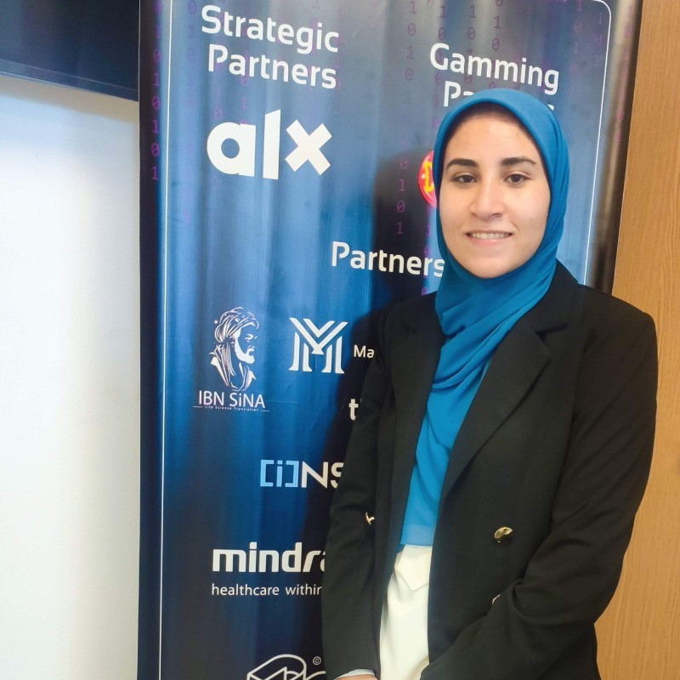

Data Science & AI Core Team
Eng. Marwan Emam
Core team of Data Science & AI @GDG-On Campus || Ex. Data Science Trainee @ITI
Eng. Jana Walid
Core team data science &AI @GDG On campus
Eng. karima mahmoud IBM Data Scientist trainee @DEPI
Eng. Yasmeen Walid Data Scientist || Data Science Core team @ GDG

Slide 6

Get ready to build our first AI model 🧐🤖

Slide 7
Session Content:
Feature Engineering
What is Feature Engineering
Data Cleaning Techniques
Encoding
Scaling & Normalization
Outlier Detection
Machine Learning Fundamentals
Machine Learning Algorithms
Supervised Vs. Unsupervised Learning
Regression Vs. Classification
Linear Regression Algorithm
Error Metrices in Regression
Feature Selection
Model Deployment
What is Deployment
Introduction to Streamlit
Key Features of Streamlit
Steps to Deploy a Model with Streamlit
Streamlit Benefits for Data Science Teams

Slide 8
01. Feature Engineering

Slide 9
1. What is Feature Engineering
Feature (x-data):
These are the input variables/column used to predict or explain the target.
For example, in a dataset of house prices, features could include the number of rooms, square footage, location, and age of the house.
Target (y-data):
The target is the variable that you want to predict or classify. It's the outcome or result that is influenced by the features.
In the same house price dataset, the target would be the house price, as that's what the model is trying to predict.
Feature Engineering: Feature engineering is the process of using domain knowledge and techniques to select, modify, or create new features that improve the performance of a machine learning model.
This can include:
Handling missing data (e.g., imputing or removing missing values).
Encoding categorical variables (e.g., one-hot encoding, label encoding).
Transforming existing features (e.g., normalizing, scaling, or log-transforming).
Creating new features (e.g., extracting date components like day of the week or month).
The goal of feature engineering is to enhance the predictive power of the model and ensure that it captures important patterns in the data.

Slide 10
2. Data Cleaning Techniques
Data Cleaning: is the process of identifying and correcting errors, inconsistencies, or inaccuracies in a dataset to ensure its quality and integrity. It involves preparing the data for analysis by addressing issues such as missing values, duplicates, and outliers. The goal is to ensure that the data is accurate, consistent, and formatted correctly for further analysis or modeling.
There is a lot of data cleaning techniques:
Remove Missing Data
Replace Missing Data
Imputation: use Predictive imputation algorithms or Fill missing values with the avg (Most Frequent Value)
Leave as Missing: Some algorithms (e.g., tree-based methods) can handle missing values natively without imputation.
Note: Avoid imputing missing values blindly, as this can introduce bias.

Slide 11
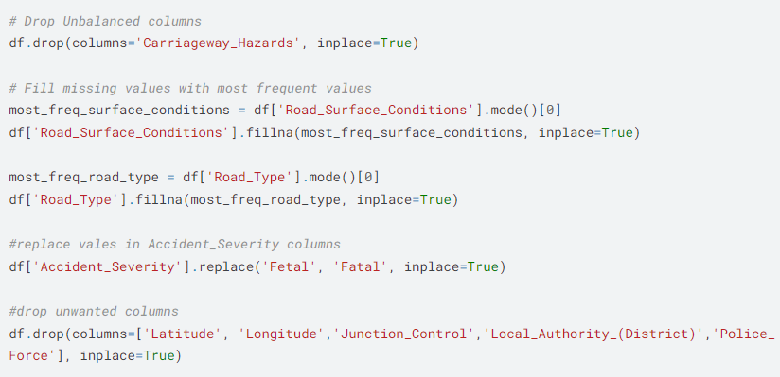
📊 Data Cleaning Techniques 📊

Slide 12
3. Encoding
Encoding: is the process of converting categorical variables into numerical formats for use in machine learning models. Different encoding techniques are used depending on the type and distribution of the data.
Encoding Types:
1. Label Encoding : Assigns a unique integer to each category.
ex: ['Red', 'Green', 'Blue'] → [0, 1, 2]
2. One-Hot Encoding: Creates binary columns for each category and assigns 1 for presence and 0 for absence.
ex: ['Red', 'Green', 'Blue'] → [[1, 0, 0], [0, 1, 0], [0, 0, 1]]
3. Binary Encoding: Converts categories to binary and assigns unique binary codes
ex: ['Red', 'Green', 'Blue'] → ['001', '010', '011’]
When To use each one:
Label Encoding is used when the categorical variables have an inherent order or ranking (e.g., 'low', 'medium', 'high').
One-Hot Encoding is used when the categorical variables are nominal (no inherent order) to avoid assigning arbitrary numerical values (e.g., 'red', 'green', 'blue').

Slide 13
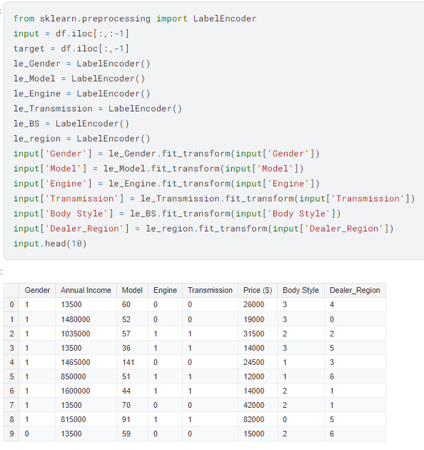
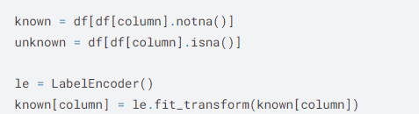
📊1. Label Encoding 📊

Slide 14
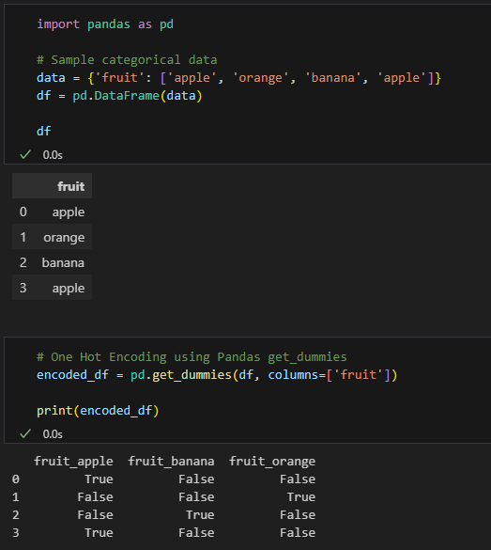
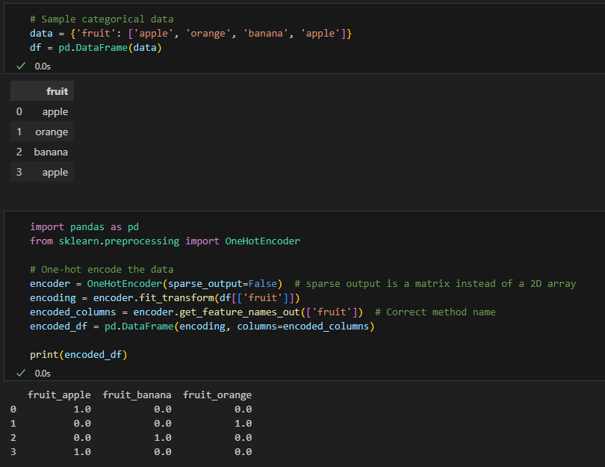
📊2. One Hot Encoding 📊
Using pandas get dummies
Using sklearn One Hot Encoding

Slide 15
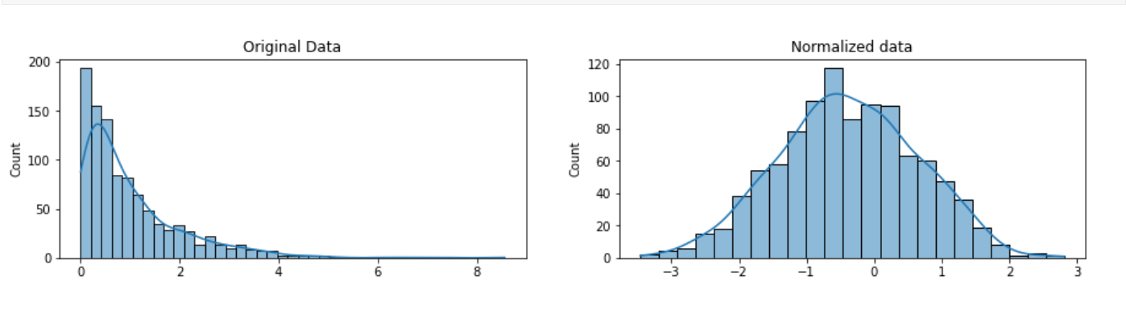
4. Scaling and Normalization
Scaling and normalization: techniques to adjust the range or distribution of numerical data to improve model performance and training stability.
Scaling adjusts the range of data to a specific scale (e.g., [0, 1] or standard deviation = 1) without changing the shape of the distribution.
Normalization transforms data to make its distribution uniform or to have a specific norm (e.g., Max Norm )
The main goal of scaling is to transform the features into a range that is suitable for machine learning algorithms and also to make the distribution normal.
Scaling and Normalization Techniques:
Min-Max Scaling:
Standard Scaling (Z-Score Scaling):
Robust Scaling:
Max Normalization

Slide 16
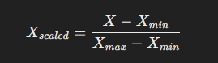
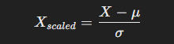
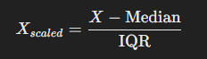
1. Min-Max Scaling: Scales features to a fixed range, usually [0, 1]
2. Standard Scaling (Z-Score Scaling): Centers features by removing the mean and scales them to unit variance
Useful for algorithms like Logistic Regression, SVM, and PCA
3. Robust Scaling: Uses the median and interquartile range (IQR) to scale features.
Effective when data contains outliers
4. Max Normalization: Scales features by dividing each value by the maximum absolute value in the feature.

Slide 17

🪄Feature Scaling & Normalization Notebook🪄 Click Here 🔝

Slide 18
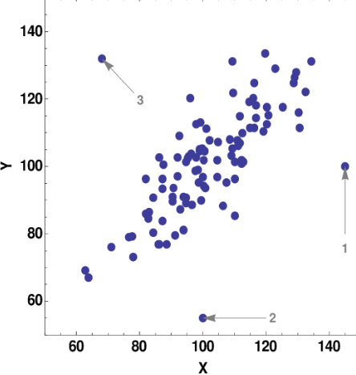
5. Outlier Handling
Outliers are data points that stand out from the rest. It can be either much higher or much lower than the other data points, and its presence can have a significant impact on the results of machine learning
Algorithms
For example, in a group of 5 students the test grades were 29, 38, 39, 27, and 2.
The last value seems to be an outlier because it falls below the main pattern of the
other grades.
Handling Techniques for Outliers:
Removal
Transformation
Robust Estimation
Visualization for Outlier Detection
1. Removal: Common methods include:
Thresholding: Outliers are identified as data points exceeding a certain threshold (e.g., Z-score > 3).
Calculate the Interquartile Range (IQR): IQR=𝑄3−𝑄1
2. Transformation: This involves transforming the data to reduce the influence of outliers. Ex: Scaling and Normalization
3. Robust Estimation: This involves using less sensitive algorithms to outliers.
DBSCAN instead of K-Means
Random forest instead of Logistic Regression
4. Visualization for Outlier Detection: use visuals to display the outliers such as boxplots or scatter

Slide 19

🤧 Break Time 🤧

Slide 20
02. Machine Learning Fundamentals

Slide 21
1. Machine Learning Algorithms
Machine Learning is a subset of artificial intelligence where algorithms learn patterns from data to make predictions or decisions without being explicitly programmed.
Machine Learning Algorithms Types:-
1. Supervised Learning Algorithms
Trained on a labeled dataset where inputs (x-data) are paired with corresponding outputs (y-data).
The model learns the relationship between inputs and outputs during training.
Once trained, it can make predictions on new, unseen data.
Example: Predicting the salary of a house using regression.
2. Unsupervised Learning Algorithms
Trained using input data (x-data) without any associated outputs (y-data).
The goal is to find patterns or relationships in the data without predefined outcomes.
Example: Segmenting customers in marketing using clustering.

Slide 22
2. Supervised vs. Unsupervised Learning
1. Supervised Learning
Uses regression for predicting continuous numerical values.
Uses classification for predicting categorical outcomes.
2. Unsupervised Learning
Uses clustering to group similar data points.
Anomaly detection to identify outliers.
Dimensionality reduction to simplify data representation.

Slide 23
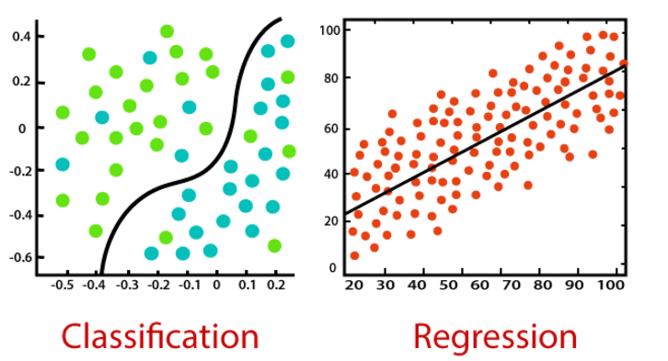
3. Regression vs. Classification
Regression: Predicts a numerical value from a potentially infinite set of outputs.
Example: Predicting the salary of a house.
Classification: Predicts a category or a small set of possible outputs.
Example: Determining whether an email is spam.
Regression Algorithms:
Linear Regression
Polynomial Regression
Ridge/Lasso Regression
Decision Tree Regressor
Support Vector Machine (SVM)
Neural Networks
Classification Algorithms:
Logistic Regression
K-Nearest Neighbor (KNN)
Naïve Bayes
Neural Networks
Support Vector Machine (SVM)
Random Forest Classifier

Slide 24
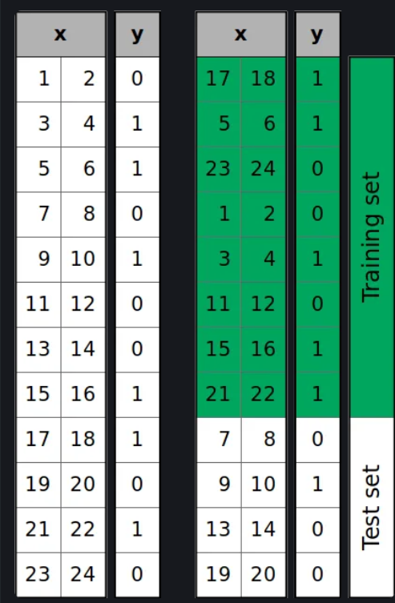
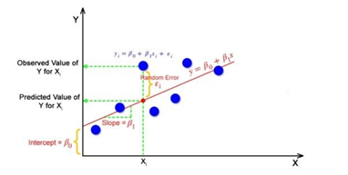
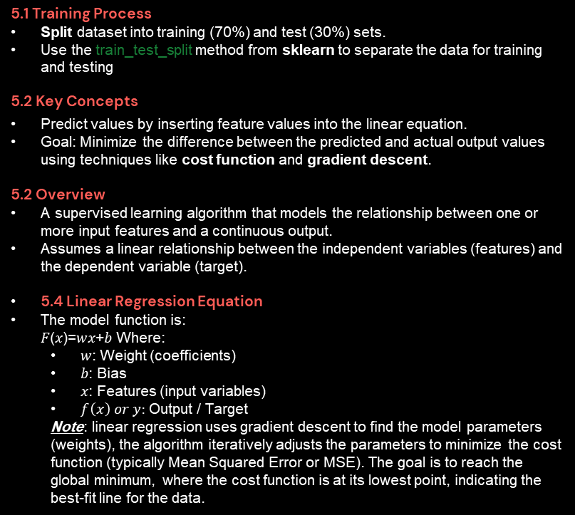
5. Linear Regression
5.1 Training Process
Split dataset into training (70%) and test (30%) sets.
Use the train_test_split method from sklearn to separate the data for training and testing
5.2 Key Concepts
Predict values by inserting feature values into the linear equation.
Goal: Minimize the difference between the predicted and actual output values using techniques like cost function and gradient descent.
5.2 Overview
A supervised learning algorithm that models the relationship between one or more input features and a continuous output.
Assumes a linear relationship between the independent variables (features) and the dependent variable (target).
5.4 Linear Regression Equation
The model function is: 𝐹(𝑥)=𝑤𝑥+𝑏 Where:
𝑤: Weight (coefficients)
𝑏: Bias
𝑥: Features (input variables)
$f\left(x\right) or y:$ Output / Target
Note: linear regression uses gradient descent to find the model parameters (weights), the algorithm iteratively adjusts the parameters to minimize the cost function (typically Mean Squared Error or MSE). The goal is to reach the global minimum, where the cost function is at its lowest point, indicating the best-fit line for the data.

Slide 25
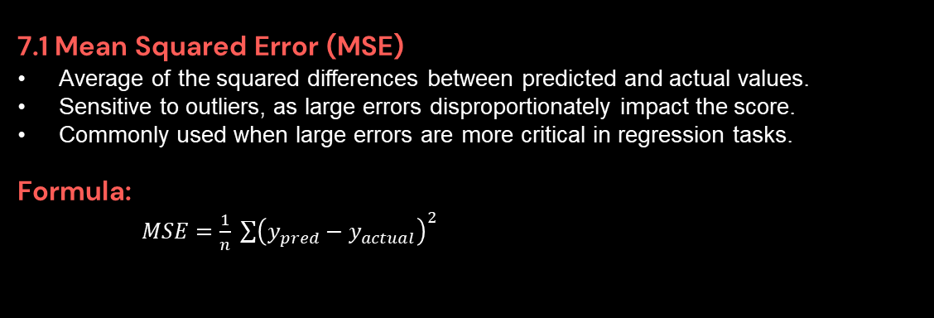
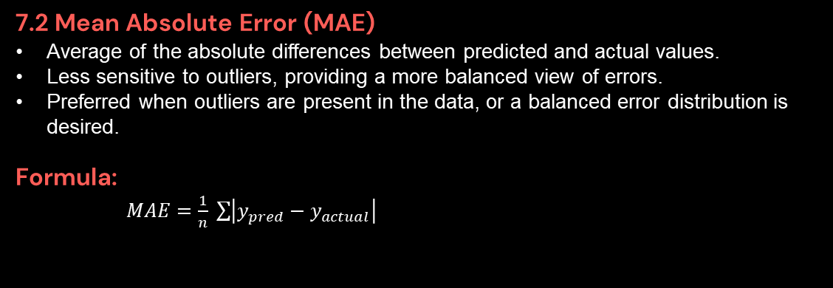
6. Error Metrics
train_test_split
7.1 Mean Squared Error (MSE)
Average of the squared differences between predicted and actual values.
Sensitive to outliers, as large errors disproportionately impact the score.
Commonly used when large errors are more critical in regression tasks.
Formula:
$MSE=\frac{1}{n} \sum{{\left(y_{pred}−y_{actual}\right)}^{2}}$
7.2 Mean Absolute Error (MAE)
Average of the absolute differences between predicted and actual values.
Less sensitive to outliers, providing a more balanced view of errors.
Preferred when outliers are present in the data, or a balanced error distribution is desired.
Formula:
$MAE=\frac{1}{n} \sum{\left|y_{pred}−y_{actual}\right|}$

Slide 26
7. Feature Selection
train_test_split
Feature Selection is the process of selecting a subset of relevant features from the original dataset to improve model performance and reduce overfitting.
Key Methods
Feature importance scores to evaluate feature relevance.
Recursive feature elimination (RFE) for iterative feature removal.
Model-based feature selection (e.g., Lasso regularization) for identifying important features that contribute to predictive performance.

Slide 27

🧠2. Linear Regression From Scratch Vs Scikit-learn📈
🧠1. Simple Linear Regression Implementation Notebook📈

Slide 28

Activity Time

Slide 29
03. Model Deployment

Slide 30
1. What is Deployment
Definition: Deployment refers to the process of making a machine learning model available for use in a production environment, enabling end-users or systems to interact with it and make predictions on new data.
Goal: Transform the model from a development stage into a functional application or service integrated with real-world workflows.
2. Introduction to streamlit
Streamlit Framework is:
Open-source Python framework for creating interactive web apps.
Built specifically for data science and machine learning workflows.
Minimal coding required; focuses on simplicity and ease of use.
Why use streamlit for model deployment
Ease of Use: Write apps using pure Python; no HTML/CSS/JS required.
Fast Development: Quick prototyping with fewer lines of code.
Customizability: Supports widgets, charts, and dynamic UIs.
Real-Time Interactivity: Automatically updates app with code changes.
Integration: Compatible with popular ML libraries like TensorFlow, PyTorch, and Scikit-learn.

Slide 31
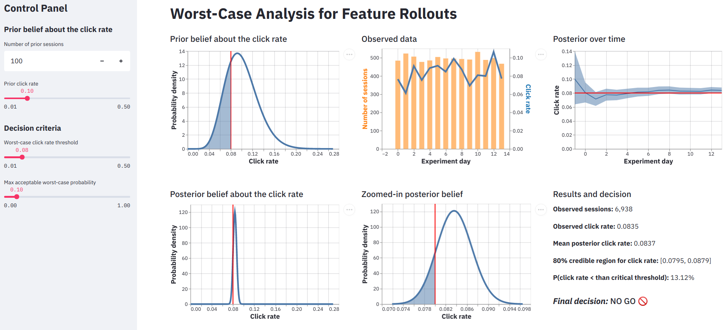
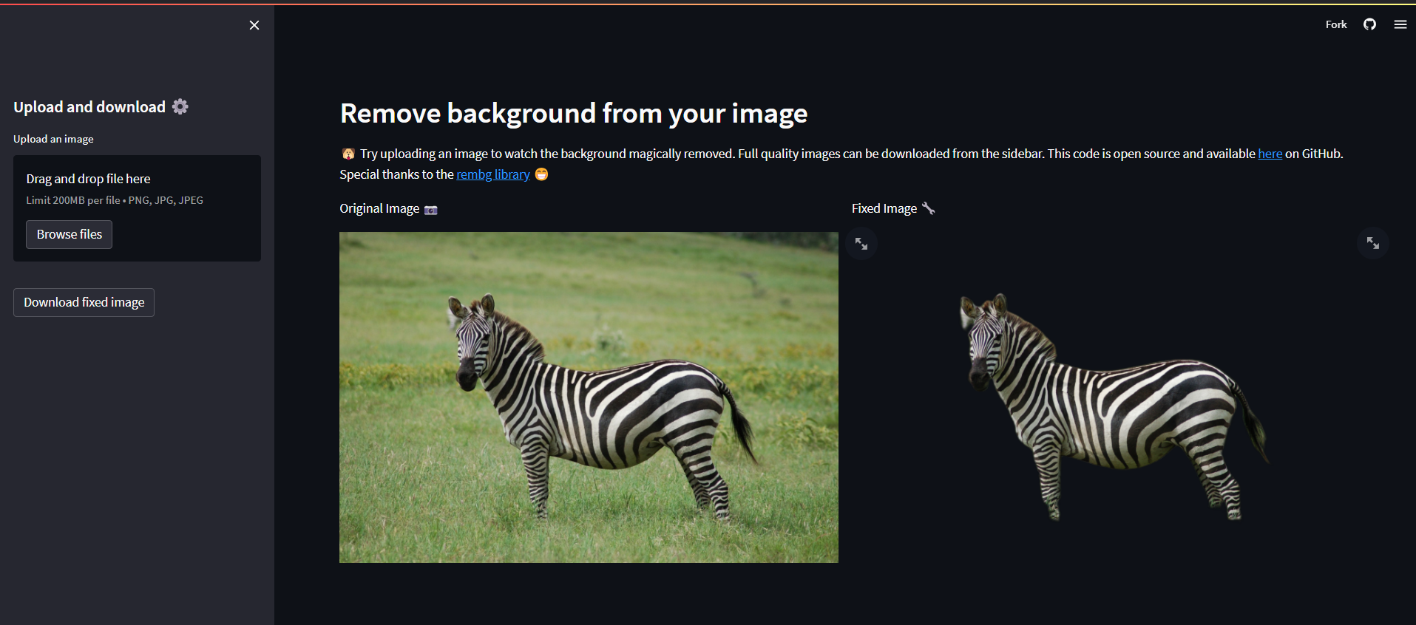
3. Key Features of Streamlit
Widgets: Sliders, buttons, dropdowns for user interaction.
Visualization: Supports Matplotlib, Seaborn, Plotly, and Altair.
File Handling: Upload and display files like CSV, XLSX, PDF and images.
Markdown Support: Add headings, text, and tables easily using HTML and CSS.
Session State: Manage variables across user interactions
Streamlit App Gallery to explore apps created and hosted on Streamlit.

Slide 32
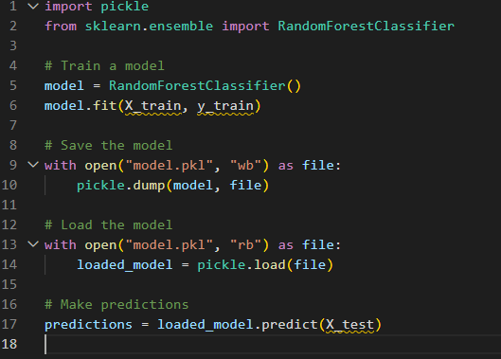
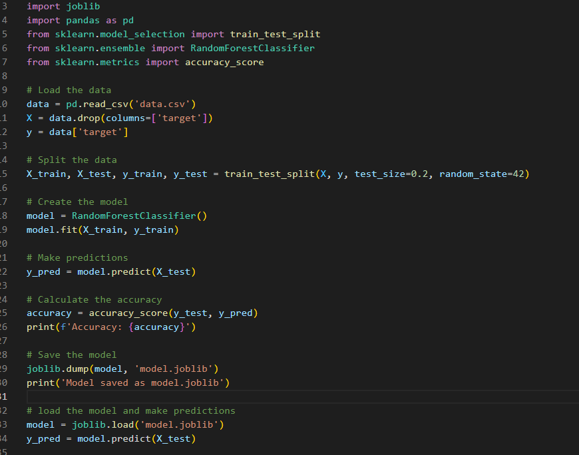
4. Steps to Deploy a Model with Streamlit
Prepare the Model: Train and save the model using a library like Scikit-learn or TensorFlow.
Build the Streamlit App:
Import libraries (streamlit, pandas, etc.).
Load the model (pickle or .h5 file).
Create input widgets (e.g., sliders, text boxes).
Display predictions using st.write() or st.metric().
Test Locally: Run using streamlit run app.py.
Deploy the App: Host on platforms like Streamlit Cloud, Heroku, or AWS.
How To Load and Save our Model
Using pickle or joblib for Traditional ML Models: Suitable for models from libraries like Scikit-learn.
By run the model from scrach

Slide 33
4. Streamlit Benefits for Data Science Teams
Why Data Science Teams uses Streamlit for deployment?
Rapid iteration for prototyping and testing.
Simplifies collaboration and sharing with non-technical stakeholders.
Eliminates the need for complex front-end frameworks.
Deployment Best Practices
Dashboard for monitoring ML model performance.
Predictive analytics tools for stakeholders.
Visualizations for exploring datasets.
Evaluate our pre-trained model using unseen data entered by user

Slide 34
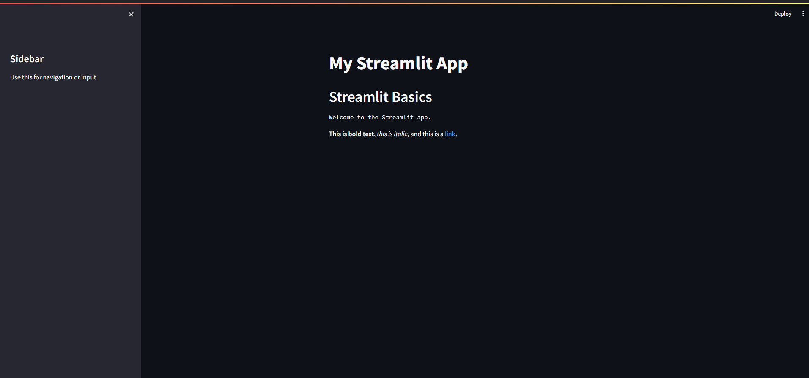
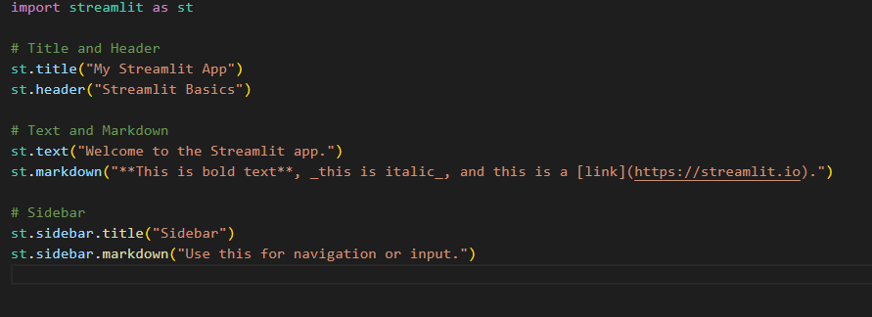
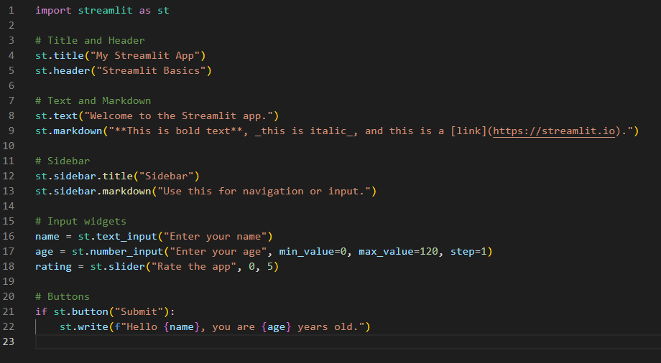
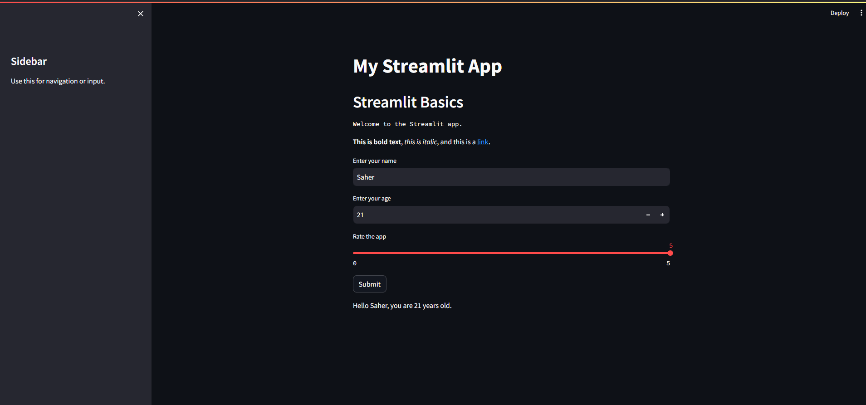
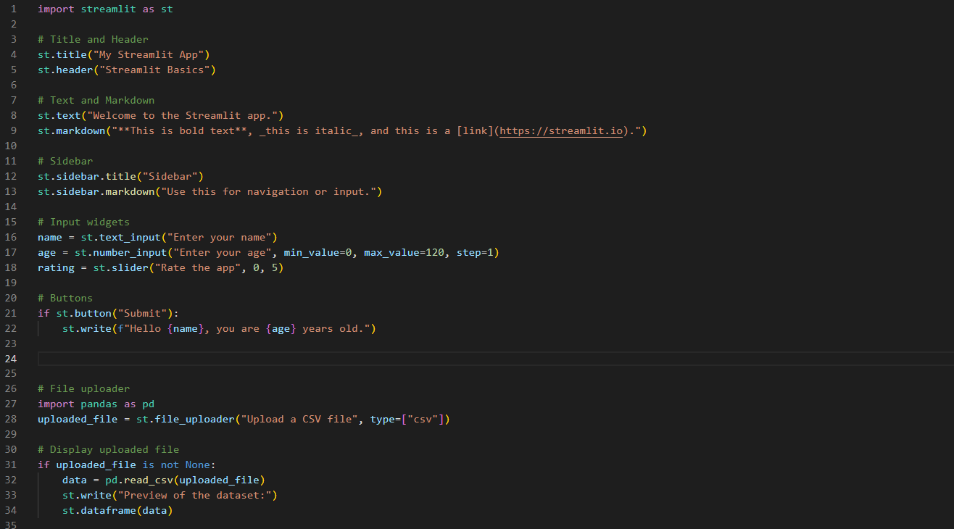
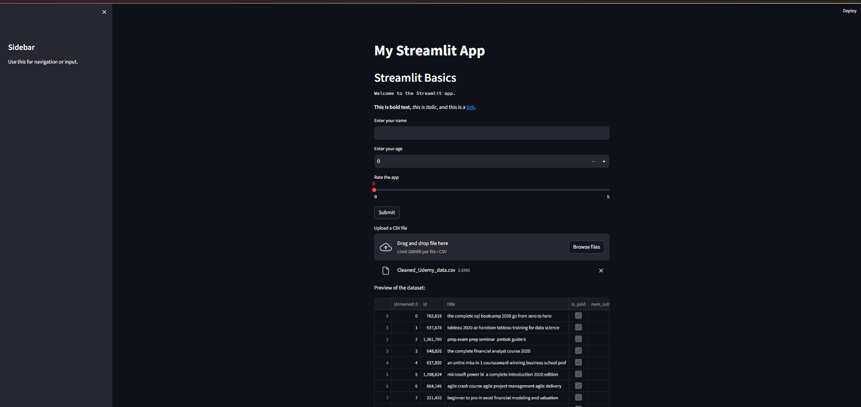

Slide 35

🤨 Practice Time 🤨

Slide 36
We are here for yourself then for our vision !
#1Global

Slide 37
Thanks!
You present GDG Family Not You !

Slide 38
Our Limit Is the Sky🚀 See you Soon !!

